Slide 1
Analyzing Denver’s Crime Data
Presented by Neil Oza

Slide 2
Additional Resources
The complete Notebook written in Python. Available on Kaggle: https://www.kaggle.com/neilb4yourking/analyzing-denver-s-crime-data
The formal report and code for this analysis: https://github.com/neiloza/Springboard/tree/master/Denver_Crime_Analysis
Packages used: Pandas, SciPy, StatsModels, Matplotlib, and Folium

Slide 3
Overview
Motivation: Denver has released all of its crime data since 2014 for public use. If analyzed, It could reveal crime trends within the city, which could help Denver’s police departments allocate resources more efficiently and reduce crime in general.
Goals: In this analysis, I intend to summarize the data using a variety of visualizations, discover any trends within the crime data, and ensure the data is accurate and/or identify the locations of any inconsistencies therein
Target Audience: This analysis is aimed to help Denver police departments better understand crimes in their city. The information would also be useful to current and incoming residents of Denver, helping them identify crime hotspots and brace themselves accordingly

Slide 4
Preliminary Analysis
The data is publicly available at the following link: https://www.denvergov.org/opendata/dataset/city-and-county-of-denver-crime.
I loaded the dataset into Jupyter Notebook as a pandas dataframe. The dataset contained 19 columns and over 400,000 rows. The columns could broadly be categorized into four categories
Offense ID columns- numeric columns that serve as unique identifiers for the crimes
Offense Type columns- columns that describe the type of crime committed
Offense location columns- provide information on where the crimes occur, such as district and neighborhood
Offense Time columns- describe the time the crime occurred and when it was reported to the police
Several of the columns are more specific or general versions of other columns. For example, Offense Category ID is a general description of the type of crime, such as larceny, while Offense Type ID is a more specific description such as theft-shoplift

Slide 5
Preliminary Analysis (cont.)
Because much of the data was redundant, it did not lend itself to machine learning
Machine learning requires a target variable and a feature set. The type of crime could work as a target variable, but the only data available as features were time and location of the crime (columns such as Incident ID wouldn’t work as features as the ID’s are arbitrary)
Since there were over a dozen types of crimes, time of day and location wouldn’t be enough to accurately classify crimes
Since many of the columns overlap, they should be checked for consistency
Many of the columns convey similar information so they should be consistent with each other
This will be tested during data wrangling

Slide 6
Preliminary Analysis (cont.)
Since the data doesn’t lend itself to machine learning, I will focus on effective visualizations
I will create visualizations showing general crime trends based on when they occurred, where they occurred, and the type of crime committed
I will combine these pieces of data to deepen the analysis

Slide 7
Data Wrangling
Before analyzing, I needed to clean the data
The goal was to check for missing values and to check for inconsistencies in the data
I checked for these inconsistencies:
Check that each Offense Code- Extension combination referred to a unique offense type
Check the Offense ID’s were correctly constructed by concatenating the Incident ID, the Offense Code, and the Offense Code Extension
First Occurrence, Last Occurrence, and Reported Dates may not be in chronological order

Slide 8
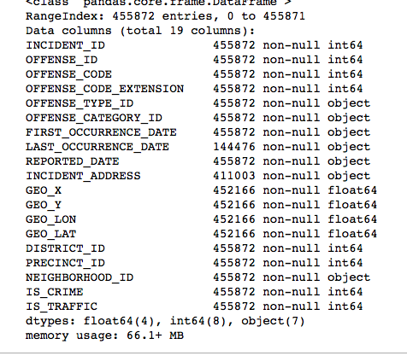
Checking for Null Values
I started by checking for null values reproduced on the left
Most columns have identical numbers of non-null values, which is a good sign
Some locations are omitted when the exact location isn’t known or to protect the privacy of the victims
Last Occurence Date is often omitted when the exact time of the crime is known
There seem to be no accidental missing values

Slide 9
Checking for Inconsistencies: Offense Code-Extensions
In this dataset, each type of crime is given a numeric representation in the form of an Offense Code and Offense Code Extension. I wanted to make sure each Offense Code- Extension combo referred to a unique type of crime.if any Offense Code- Extension referred to multiple types of crimes, that would mean that particular code was ambiguous and should be corrected
It turns out all of the Offense Codes-Extensions referred to unique crimes, so no mistakes on this front

Slide 10
Checking for Inconsistencies: Offense ID’s
Offense ID’s are unique identifiers for each offense incident. They are constructed by concatenating the Incident Id, the Offense ID, and the Offense ID Extension in that order
I wanted to make sure all of the Offense ID’s were properly constructed. I did this by reconstructing the Offense ID from its component columns and checking if any reconstructions didnt match the listed Offense ID
All of them matched, so once again, the data was consistent on this front.

Slide 11
Checking for Inconsistencies: Dates
The dataset contains First Occurence Dates, Last Occurence Dates, and Reported Dates. Chronologically, First Occurence Dates should come first, Reported Dates should come last, and Last Occurence Dates should be in the middle or not exist
I wanted to make sure these dates were all chronological. Since they were all datetimes, I converted their type and subtracted the First Occurence Date by the Last Occurence Date, and did something similar for the Reported Date, and printed out any negative values
This time, there were about 80 mistakes. In these entries, either the Last Occurence Date was before the First Occurence Date or the Reported Date preceded one of the occurrence dates. The Offense ID’s of the relevant entries are listed in my report so they can be easily accessed, reviewed and corrected

Slide 12
Filtering the Data
I had finished checking the data for inconsistencies and null values
I decided to filter out the data I wouldn’t be using to make analysis simpler
I filtered out the handful of entries with achronological dates, since I knew they had at least one error
The dataset contained traffic incidents in addition to crimes. I was only interested in criminal data for this analysis, so I filtered out the traffic data
I filtered out all of the crimes committed in 2019, as recent crime data is less accurate and subject to change
At this point, the data was clean and ready for analysis!

Slide 13
Data Analysis: The Plan
The goal of my analysis is effective data visualization
The data contained three pieces of information that could be effectively visualized: the type of crime, the location of the crime, and the time of the crime. The dataset contains these bits of information in multiple forms. I selected representative elements to keep my analysis concise
I used the Category Type ID to represent the type of crime since the values described the type of crime, but only took on 14 possible values so creating bar graphs from the data would be reasonable
I used the District ID to represent the location, as it was more readable than latitude/longitude data and had only 7 possible values, which once again lent itself to visualization
I used the Reported Date to represent the time, since that is the time the offense becomes relevant to the police
Some graphs will be omitted for brevity. They can be found in the notebook for reference

Slide 14
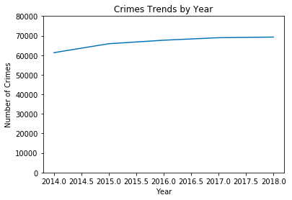
Crime in Denver over the Years
This is a graph of crimes per year
There have been around 60,000-70000 crimes every year in Denver
Crime rates are increasing, but the rate of increase has slowed

Slide 15
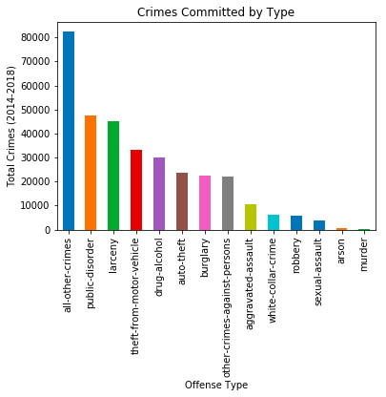
Crimes by Category
This is a graph of crimes grouped by category
All other crimes is the largest crime category
Forms of theft (larceny, burglary, auto-theft, etc) are the most common type of crime in Denver
Violent crimes are fairly uncommon

Slide 16
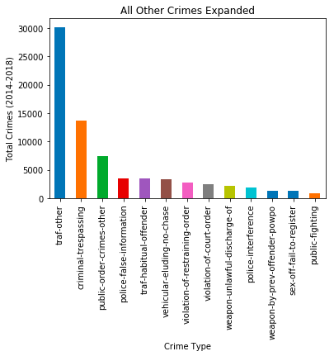
All-other-crimes Expanded
This graph expands the all other crimes category to show it’s component crimes
Traffic related crimes and trespassing comprise most of this category

Slide 17
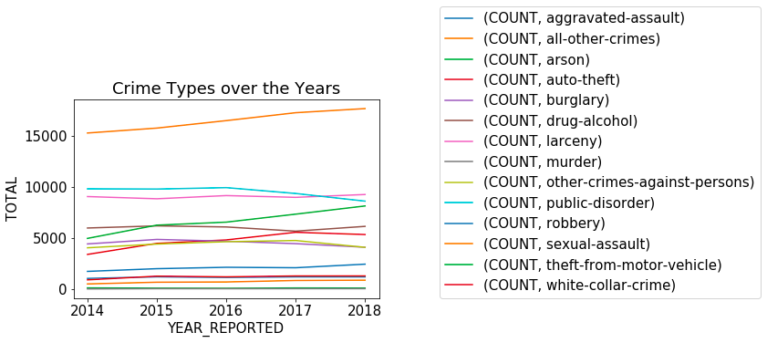
Crime Types through the Years
This is a graph of each crime category over the years
All other crimes, theft from motor vehicles, and auto theft have increased significantly the past five years
The increase in all other crimes is mostly due to increase in trespassing
Public disorder is the only crime to decrease in prevalence in that time

Slide 18
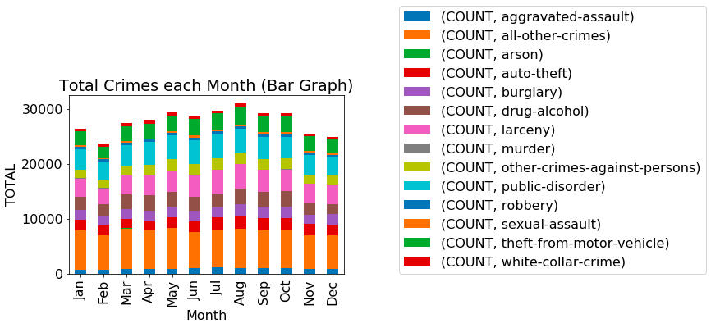
Crime Types by Month
This graph shows total crimes organized by month
Crimes seem more common in the summer compared to the winter. A hypothesis test confirmed
Denver PD should hire more police to handle the uptick in crime during the summer, if possible

Slide 19
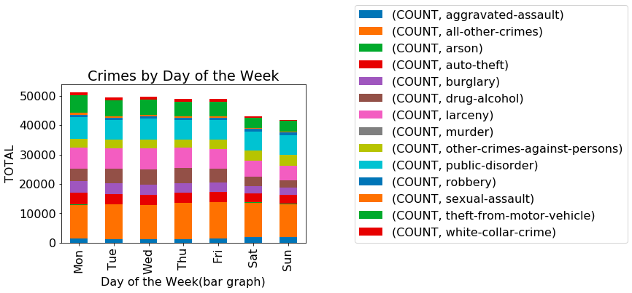
Crimes by Day of the Week
This graph shows crime organized by day of the week it occured
Crimes seem more common on weekdays than weekends. This was confirmed by a hypothesis test
More on duty police officers are required on weekdays compared to weekends to handle the larger number of crimes

Slide 20
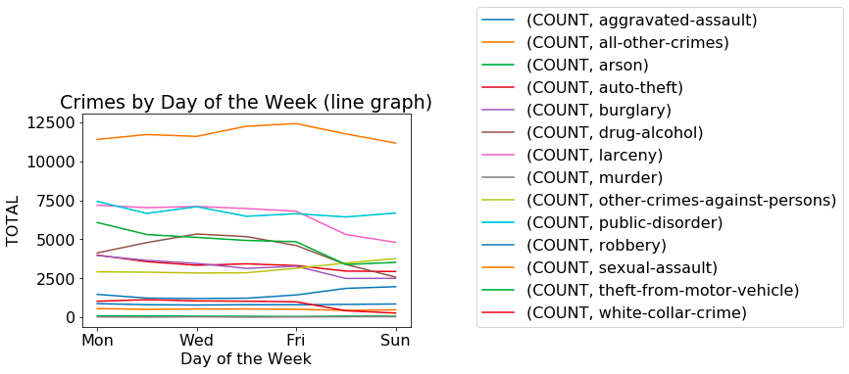
Crimes by Day of the Week (cont.)
This graph shows crimes by category organized by day of the week. Using line graphs shows trends in individual crimes better
Forms of theft (larceny, theft-from-motor-vehicle, burglary, etc) are more common on weekdays
Forms of assaults are more common on weekends
Stronger police officers should be on call during the weekends to handle higher rates of assaults

Slide 21
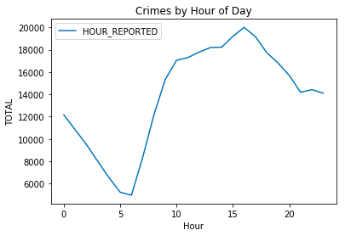
Crimes by the Hour
This graph shows crime counts by the time they occured. The graph uses military time, so 10 means 10 AM and 20 means 8 PM
Crimes are most common from 8 AM to 8 PM and are uncommon from 1 AM to 5 AM
The notebook contains individual categories of crimes organized by hour. This revealed:
Assaults occur at night
Thefts occur during working hours 8AM- 5PM
Recommend keeping more police on staff from 8 AM to 5 PM, and keeping stronger police on staff at night

Slide 22
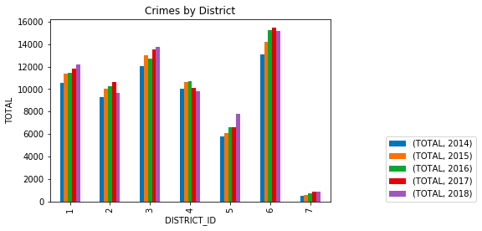
Crimes By District
This graph organizes total crimes by district and year occurred
Districts 6, 3, and 1 have the highest amounts of crime
District 7 has the fewest crimes (it’s an airport)
Crime has increased in most districts except district 4 and possibly district 2

Slide 23
Crime by District in Depth
I also analyzed types of crime by district. I’ve reproduced some representative graphs on the next slides, but for convenience here are the main takeaways:
Nonviolent forms of theft, such as burglary, white-collar-crime, and theft from motor vehicles tend to occur in District 3
District 6 leads Denver in assaults, robberies, and drug-alcohol crime. Pedestrians walking in these areas should be wary
District 2 has a surprisingly high rate of murders. However, given the low number of murders total, this may be due to random chance. District 2 has low crime rates for other types of crimes
Given these trends, I advise Denver PD and the city of Denver to allocate theft prevention resources to District 3 and drug prevention resources to District 6. Pray for District 2

Slide 24
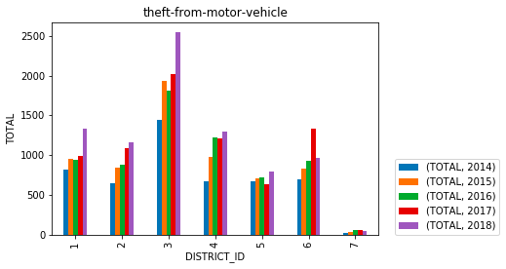
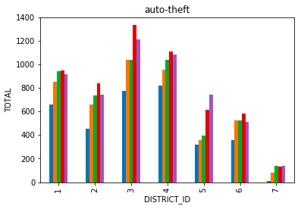
Crimes by District in Depth (cont.)

Slide 25
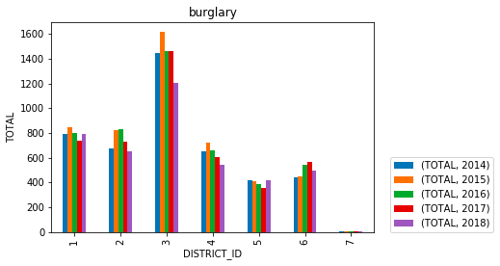
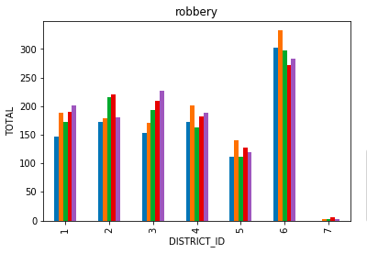
Crimes in Depth (cont.)

Slide 26
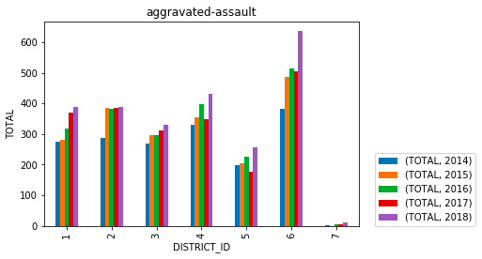
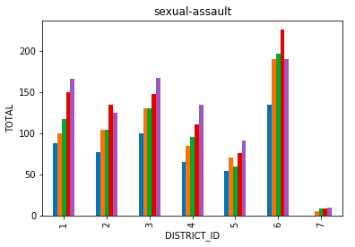
Crimes By District in Depth (cont.)

Slide 27
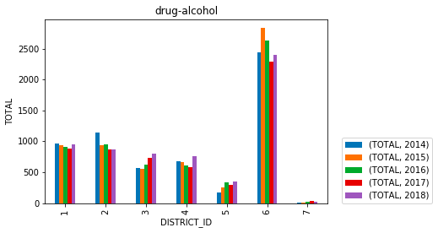
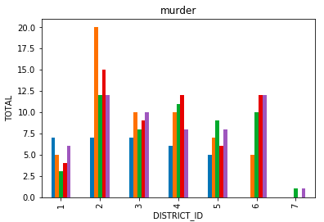
Crimes By District in Depth (cont.)

Slide 28
Heatmap
I created a heatmap generating function called heatmap_creator. It can be used to generate heatmaps over the city of denver to identify where crimes are occuring
To use the function, pass the function arguments in the form of (‘column_name’, ‘column_value’). It will filter the dataset for entries that match the pair, and generate a heatmap of those entries. You can pass multiple filters this way
The code requires javascript to run. I recommend using a Jupyter Notebook
An example heatmap is produced on the following slide. It shows all crimes that occured in Denver during July 2017 that were drug-alcohol related

Slide 29
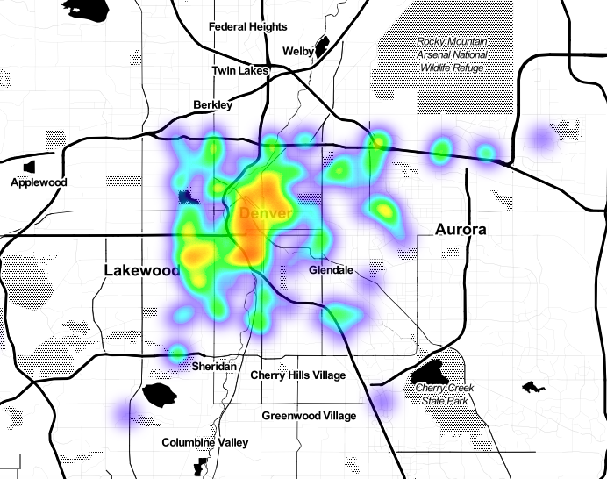
Heatmap of Drug-Alcohol Crimes during July 2017
The function used to generate the heatmap to the right was:
heatmap_creator(('MONTH_REPORTED',7),('YEAR_REPORTED',2015),('OFFENSE_CATEGORY_ID','drug-alcohol'))
The heatmap can be zoomed in when opened in Jupyter Notebook

Slide 30
Next Steps
This dataset also contains information on Denver traffic incidents. Combining this information with traffic count data could reveal which intersections are problematic and should be redesigned
Combining this dataset with population data could reveal what areas have a high crime rate per capita
Combining this dataset with police budget information could reveal what expenditures reduce crime and possible sources of waste
Combining this dataset with information on criminals could help determine what criminals are repeat offenders and which criminals are likely to not show up for court after posting bail

Slide 31
Conclusions
Denver’s Crime Data is mostly free of errors, with the exception of a few out of order dates
Denver crime is concentrated during the weekdays and from 8 AM to 8 PM. I recommend keeping larger numbers of police officers on call during those times
Crime is also more common during the summer than the winter. However, hiring additional police officers for a season may be impractical
Thefts from motor vehicles have increased noticeably over the past five years. I recommend a PSA reminding people to lock their cars. Gentle reminders are surprisingly effective
District 3 seems to have large number of thefts, so investing in security cameras or the like might be a good idea. District 6 has high rates of drug-alcohol crime and higher rates of violent crime compared to other districts. However, violent crimes aren’t too common on the whole

Slide 32
Special Thanks
Christine Wyckoff for clarifying the dataset for me
Nikoloz Skhirtladze for mentoring me as I developed this analysis

